Slide 1

UNH SEDS
CEPS Engineering Organization
High Power Rocketry

Slide 2
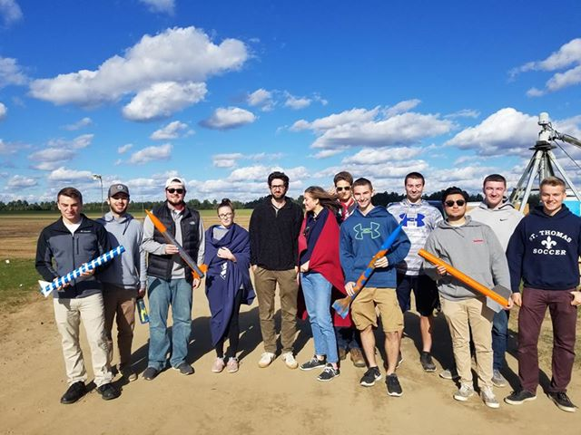
Our history
UNH SEDS has been around for 5 semesters. During that time we have completed 3 classes of rockets and are currently working on a hybrid engine rocket utilizing a liquid oxidizer and a solid fuel.
Experimental Class
Consisting of 2 Rockets.
Aether Class.
Consisting of 7 Rockets.
USRC Carbon Fiber Class.
Consisting of 1 Rocket.
Hybrid Engine Rocket.
Current production.
Compilation Video [Next Slide]

Slide 3
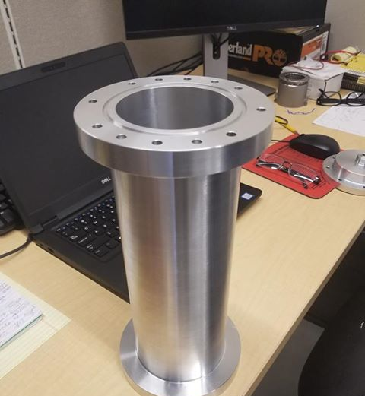
Current Operations
Project Runaway started in September 2018 with the research and development stages. In November 2018, we began the manufacturing and assembly stage which is nearly finished, with an estimated end date of February 1st.

Slide 4
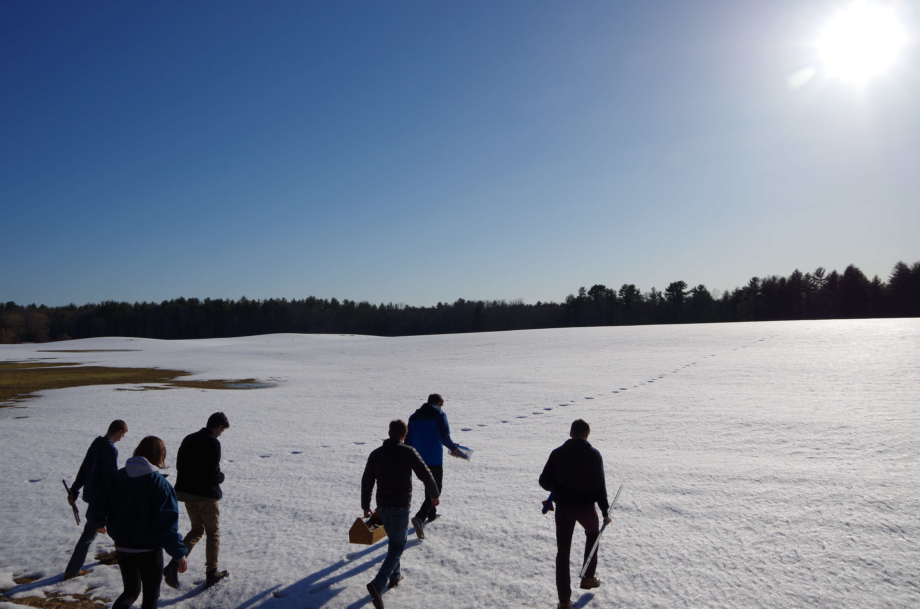
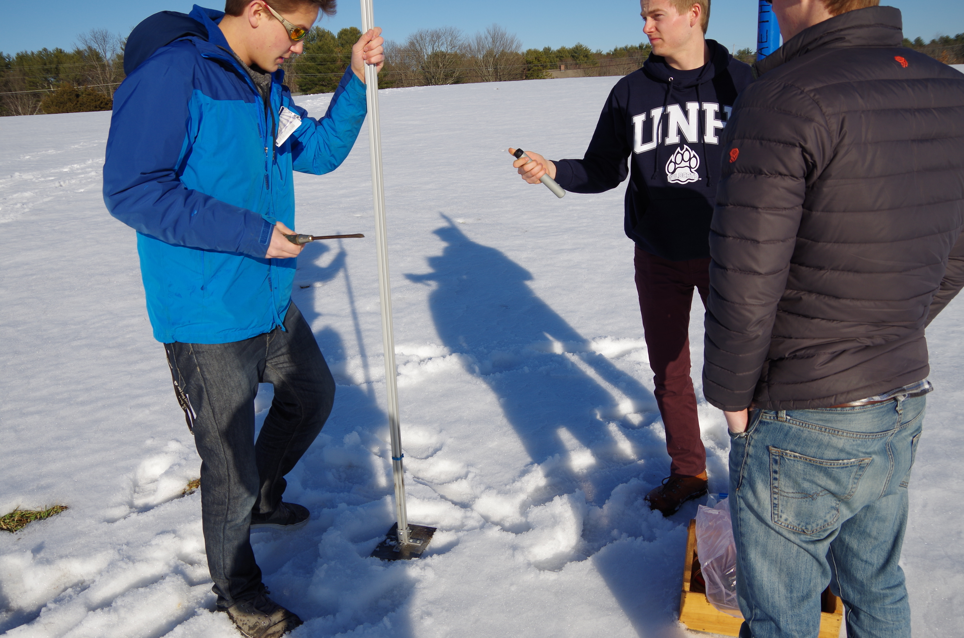
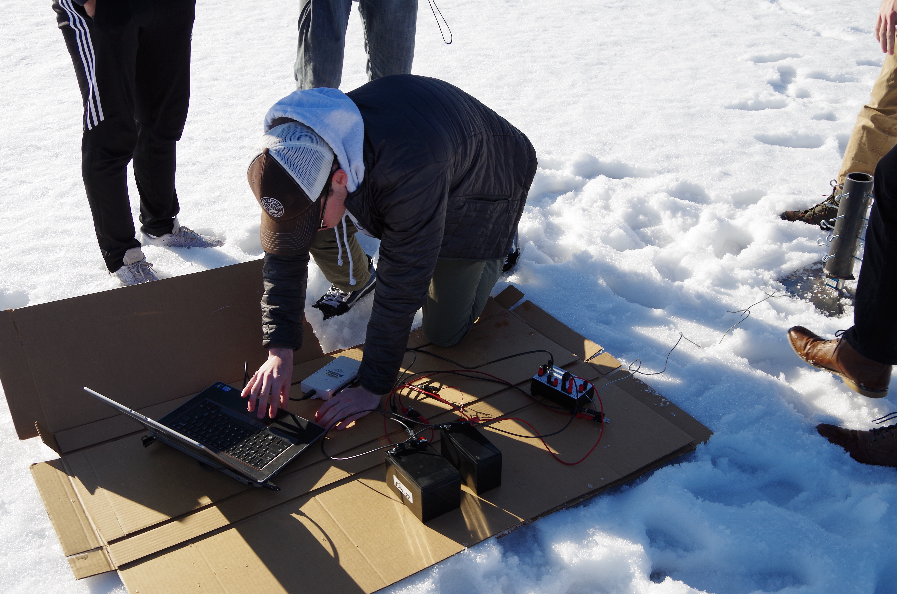
The Goal
Rocket launches are the culmination of hundreds of hours of student-lead engineering work. They are exciting, no matter the outcome. With the progression of more complex, and consequently, more powerful rockets, actions must be taken to keep all spectators completely safe.

Slide 5
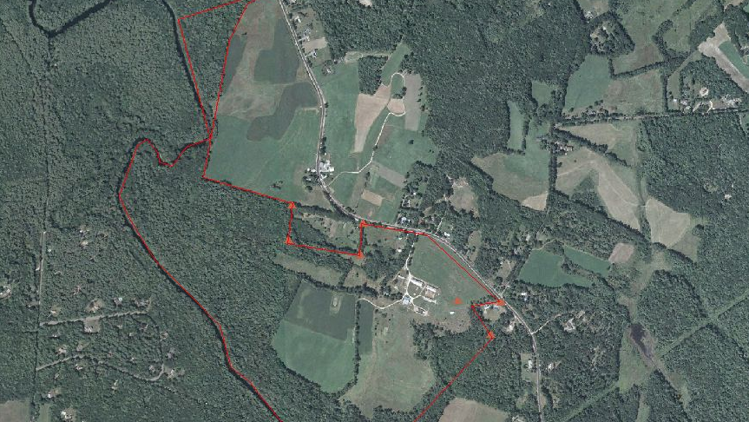
Burley-Demeritt Farm

Slide 6
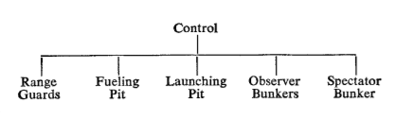
Making Future Operations Safest

Slide 7
Launch and Test Operations - Options
Semi-Permanent Field Facility
Temporary (Same Day) Field Setup and Take Down
Dynamic Field Facility with Two Trailers

Slide 8
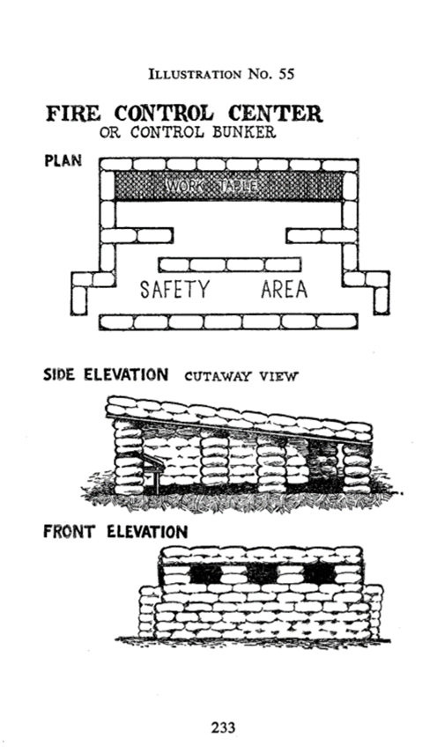
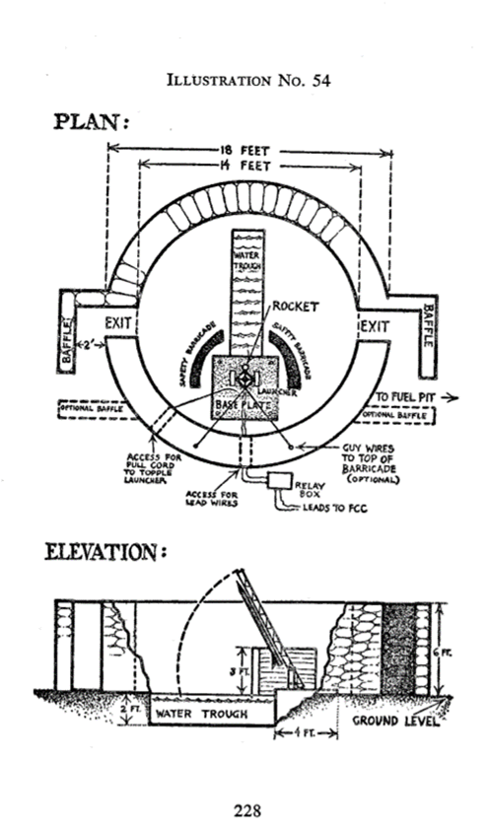
Semi-Permanent Option
Control Center
Advantages
Highest safety
Improve and optimize with time
We can be on-site, offering quickest response time if something goes wrong
A true ‘Home Base’ for all rocket testing activities
Helps secure the future of UNH SEDS
Disadvantages
Full Weekend assembly required
All day – weekend disassembly required (if needed)
Details of this would need to be worked out, i.e. sandbag storage and transportation
Launch Center

Slide 9
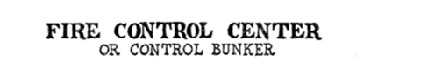


Slide 10
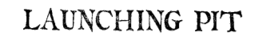
Note: We don’t plan to dig or include that part of the design.

Slide 11
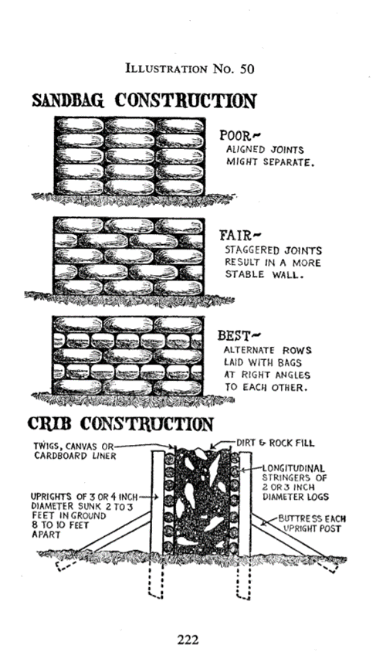


Slide 12
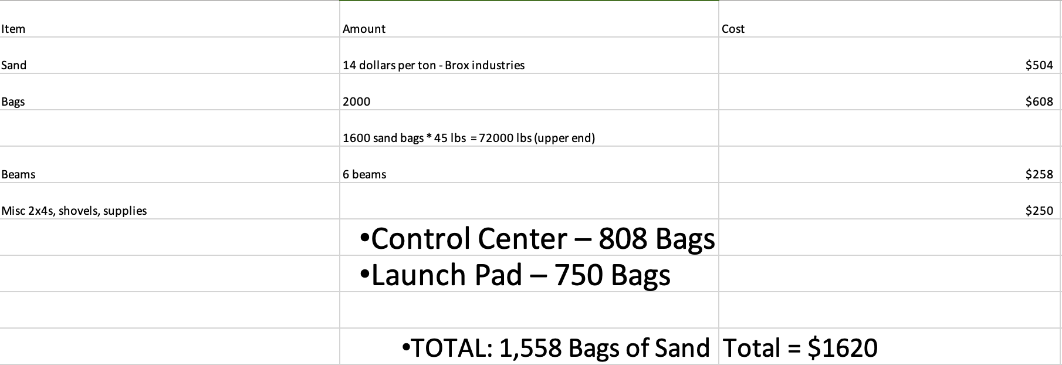
Initial Building Costs
Future Costs to increase safety, field communication and technical equipment: $3,000.00

Slide 13
Temporary (Same Day) Field Setup and Take Down Option
The idea would be to set up sandbags just around the test object, and all observers and ignition team are as far away as they can while still being able to provide successful ignition. This depends on our remote system.
Advantages
Does not require any semi-permanent structures or trailers
Leaves the field empty while not testing
Disadvantages
Minimal safety features as set-up and take-down are the same day
Requires a significant amount of physical labor during the day of testing
Inconsistent field conditions with each different test

Slide 14
Dynamic, Two Trailer Option
Advantages
Very mobile with a transport vehicle
Still provides safety structures
Disadvantages
Several-day assembly required
Ability to obtain desired trailers, expensive
Sacrificing safety for mobility
Unsure about the how safe these could really be

Slide 15


Next Steps
Ideal Field Selection
Largest UNH-owned field available
Approval for the building of semi-permanent safety structures
Obtain UNH-sourced funding
CEPS Funding
SAFC Funding

Slide 16
Questions, Comments and Concerns?

Slide 17
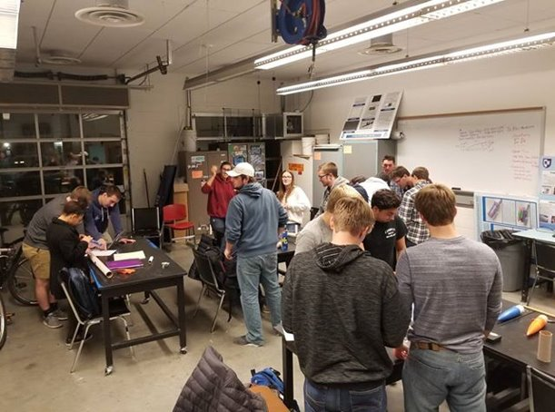
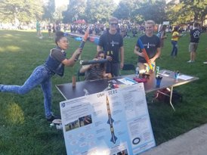
Who we are
UNH SEDS, or the University of New Hampshire Students for the Exploration and Development of Space, is an interdisciplinary engineering team motivated by our shared passion to further human knowledge in space exploration by combining our studies with meaningful projects.
Our team consists of over 30 members from all grades and fields of study. We participate in outreach to the greater seacoast area, research and competitions through the CEPS USRC and more.

Slide 18
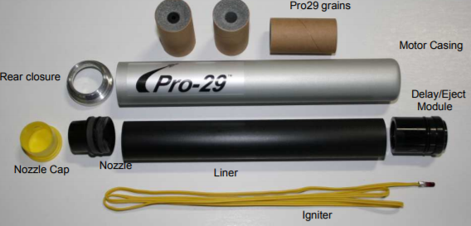
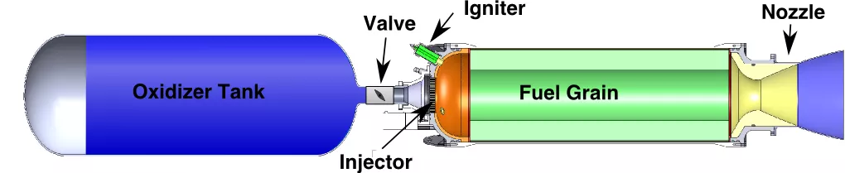
Previous rocket engines
Hybrid Rocket Engine
Purchasable at,
https://www.apogeerockets.com/Rocket_Motors/Cesaroni_Propellant_Kits

Slide 19
